Slide 1
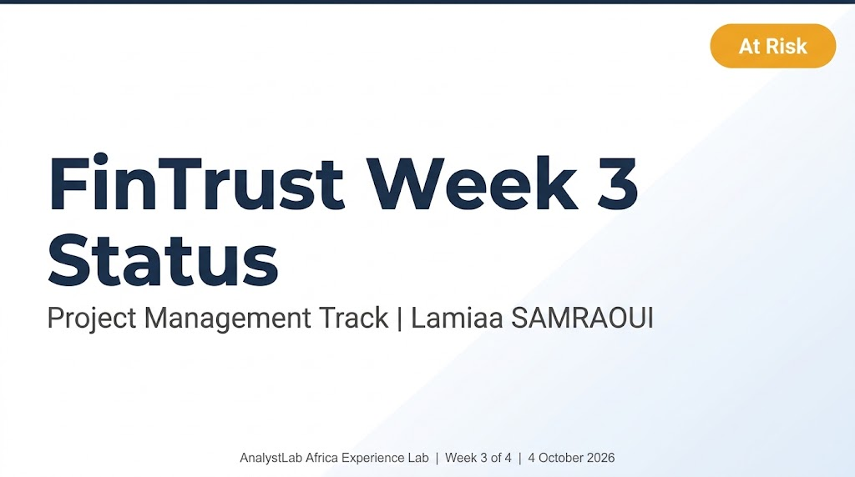

Notes:
Week 3 status for the PM track. Project health is At Risk, trending toward On Track if Week 4 mitigations hold.

Slide 2
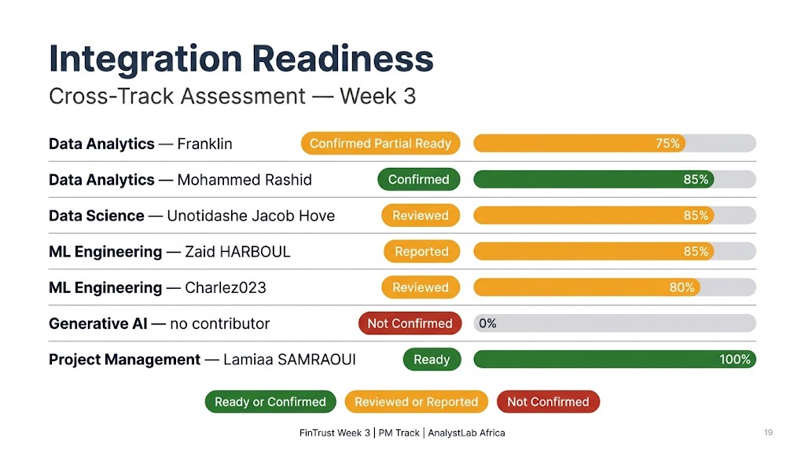
Notes:
Evidence levels: Reported = contributor stated completion publicly; Reviewed = PM reviewed the public output. No track reaches Confirmed or Validated in Week 3.

Slide 3
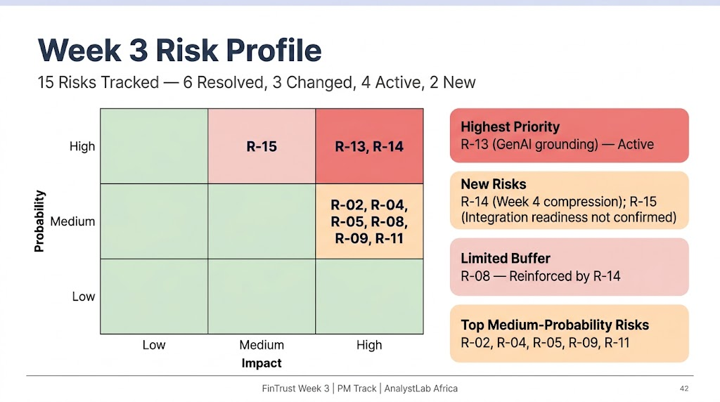
Notes:
Replace the dashed box with Figure 2 (Risk Heat Map) from the Week 3 document.

Slide 4
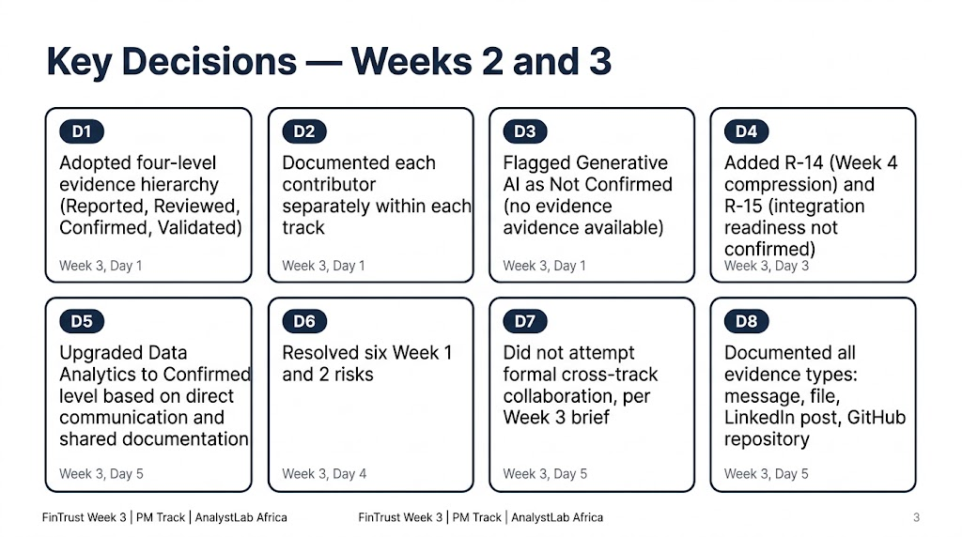

Slide 5
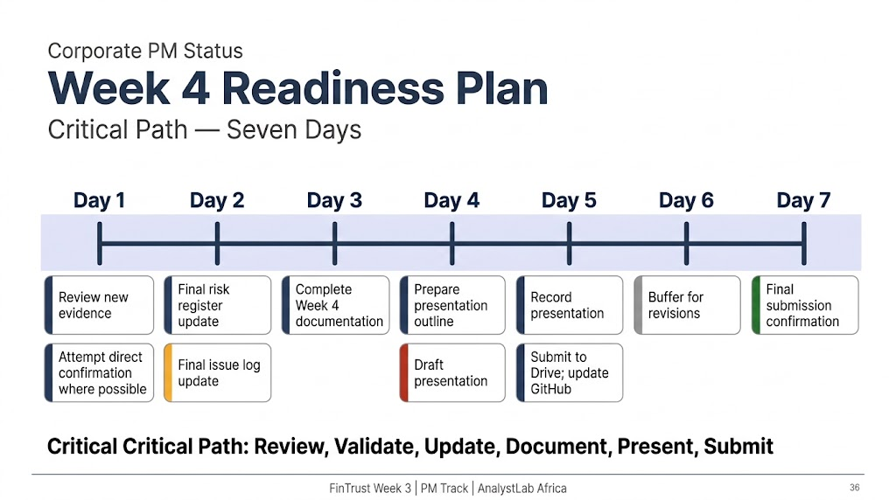

Slide 6
